Slide 1
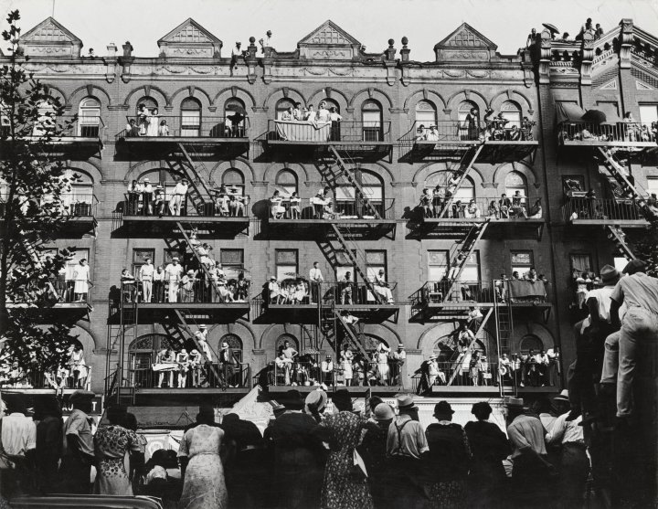



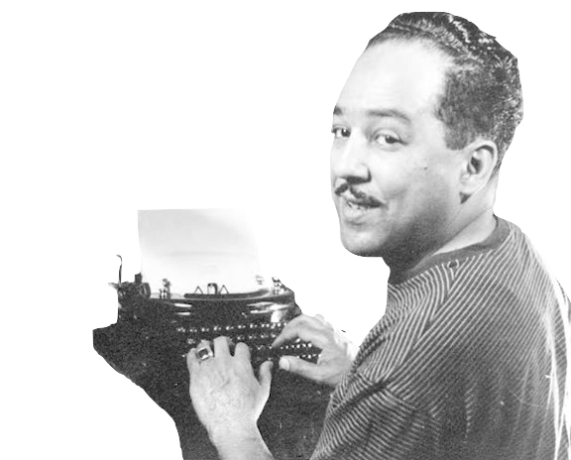
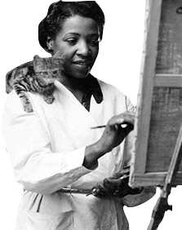
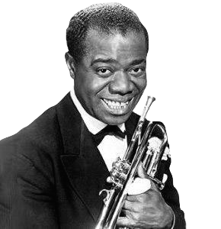
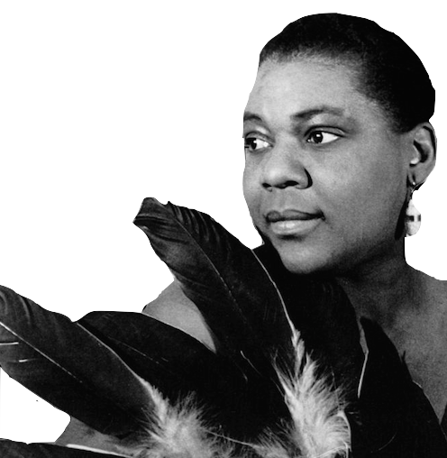

Slide 2
Directions:
Set up 6 stations around the classroom- one for each Star of the Harlem Renaissance.
2 stations will need to have a computer or ipad with a splitter to allow multiple students to watch/listen to the two music pieces (Louis Armstrong and Bessie Smith- links to YouTube videos provided). Print out copies of the paintings and poems and the biography sheet for each artist. Give each student a copy of the activity worksheet and divide up students into teams of 4-5 at each station. Have students rotate through each station spending around 5-8 minutes learning about and experiencing work by each artist. Have them fill out their questions as they go through the “art show”.

Slide 3

1901-1971
Born in New Orleans, Louisiana, Louis Armstrong was a trumpeter, singer, band leader, soloist, and even entertained as a film star and comedian. Nicknamed Satchmo, Armstrong is considered the most influential musician in jazz history and had many hit songs such as “Star Dust” and “What a Wonderful World”. He was also known for his scat singing in hits like “Heebie Jeebies.”
Armstrong came from one of the roughest neighborhoods in New Orleans and was arrested as a youth for firing his father’s gun into the air at a New Year’s celebration. He was introduced to Jazz Music at the Colored Waif’s Home for Boys where he learned to play the coronet and fell in love with music.
Starting in 1919, Armstrong spent his summers performing with
riverboat bands where he gained more musical skills and learned to
better read music. He also learned from many other great Jazz
musicians. He helped to bring Jazz to northern cities such as
Chicago and New York.
Louis filmed movies such as “Pennies from Heaven” starring Bing
Crosby and later “Hello, Dolly” starring Barbara Streisand in 1969.

Slide 4
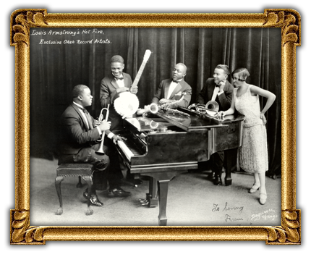
When the Saints
Go Marching In
(Chorus)
Oh when the saints
Go marching in
Oh when the saints go marching in
Oh how I want to be in that number
When the saints go marching in
https://www.youtube.com/watch?v=wyLjbMBpGDA
Originally a gospel hymn. First recorded by Louis Armstrong and his orchestra in 1938.

Slide 5

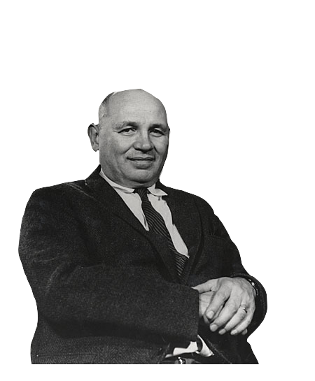
1911-1988
Born in Charlotte, North Carolina, Romare Bearden was marked by exceptional talent that included a wide range of interests and abilities. Among his many talents, Bearden was a cartoonist, art editor, set and costume designer and a gifted writer. As an artist, he experimented with many types of mediums and artistic styles. His artistic pieces ranged from collages, watercolors, oil paintings, and photomontages. Bearden was active in the Harlem Cultural Council and the Harlem Artists Guild. He drew inspiration from various artists like Cezanne and
Picasso as well as from African art, Byzantine
Mosaics, Japanese prints, and Chinese landscape
paintings. His early works focused on unity and cooperation in the African-American community.
Romare was married to Nanette Rohan in1954.
For nearly 30 years he worked as a social
worker with the New York City Department
of Social Services, working to better his
community by day, and focusing on his art
in the evenings.

Slide 6
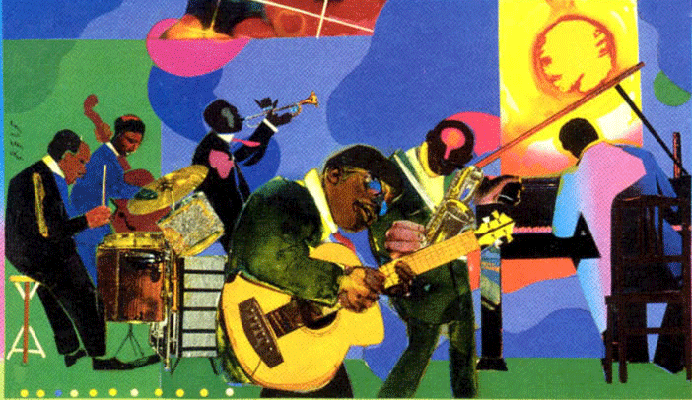
Romare Bearden, “Jammin’ at the Savoy”, 1968, Collage

Slide 7
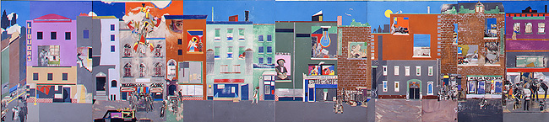
Romare Bearden, “The Block”, 1971, Collage

Slide 8
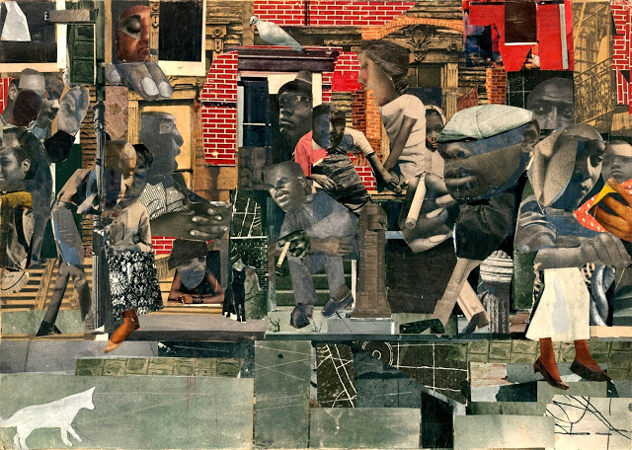
Romare Bearden, “The Dove”, 1964, Collage

Slide 9


1902-1967
Born in Joplin, Missouri, (James Mercer) Langston Hughes published his first poem in 1921. Hughes was a poet, novelist, social activist, newspaper columnist, and playwright who was best known as a leader of the Harlem Renaissance.
Both of Hughes’ great-grandfathers were white slave
owners from Kentucky. His great-grandmothers were both
African-American slaves. His mother was a school teacher
and his father left his family fleeing to Mexico in hopes to
escape racism. His mother was often seeking work and traveled so Langston was mostly raised by his grandmother.
Hughe’s first published work was a part of a journal put out by the N.A.A.C.P. called “The Crisis.” Hughes and his fellow Harlem Renaissance artists were trying to depict the reality
of life for America’s black
population. They criticized
division and segregation not only
in Jim Crow regions, but within
their own black communities. His
poetry and fiction portrayed the
lives and struggles of working class
black Americans.

Slide 10
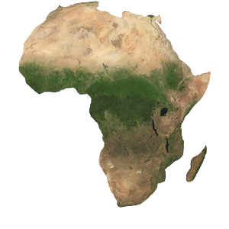
1.
Afro-American Fragment
So long,
So far away
Is Africa.
Not even memories alive
Save those that history books create,
Save those that songs
Beat back into the blood-
Beat out of blood with words sad-sung
In strange un-Negro tongue-
So long,
So far away
Is Africa.
Subdued and time-lost
Are the drums- and yet
Through some vase mist of race
There comes this song
I do not understand,
This song of atavistic* land,
Of bitter yearnings lost
Without a place-
So long,
So far away
Is Africa’s
Dark face.
*Atavistic = going back to something ancient or in your distant past.

Slide 11
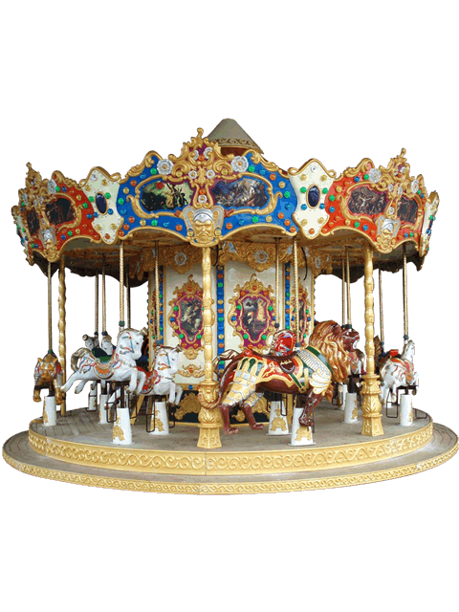
2.
Merry-Go-Round
Colored Child at Carnival
Where is the Jim Crow* section
On this merry-go-round,
Mister, cause I want to ride?
Down South where I come from
White and colored
Can’t sit side by side.
Down South on the train
There’s a Jim Crow car.
On the bus we’re put in the back-
But there ain’t no back
To a merry-go-round!
Where’s the horse
For a kid that’s black?
*Jim Crow = Segregation laws that kept people separated by race in the South.

Slide 12

3.
I Dream A World
I dream a world where man
No other man will scorn,
Where love will bless the earth
And Peace its paths adorn.
I dream a world where all
Will know sweet freedom's way,
Where greed no longer saps the soul
Nor avarice blights our day.
A world I dream where black or white,
Whatever race you be,
Will share the bounties of the earth
And every man is free,
Where wretchedness will hang its head
And joy, like a pearl,
Attends the needs of all mankind-
Of such I dream, My world!
Scorn = despise, hate
Adorn= Decorate, beautify
Avarice= Greed for wealth
Bounties= Blessings
Wretchedness= Sorrow, despair

Slide 13

1894-1937
Born in Chattanooga, Tennessee in 1894, Bessie Smith signed a recording contract with Columbia Records in 1923. She was quickly among the highest paid African American performers in the United States. She was nicknamed the “Empress of Blues” and was the most popular blues singer
in the 1920’s and 1930’s. After experiencing great
popularity in the 20’s, the Depression in the early 1930’s left her struggling financially. Smith began to adapt her style to incorporate the growing popularity of Swing
music and continued to travel and perform.
Smith died at the age of 43 when on her way to a
show in Tennessee the vehicle
she was riding in sideswiped a
truck and she was thrown from
the car.
Since her death, her music has
continued to attract new fans
and has sold considerably well.

Slide 14
Nobody Knows You
When You’re Down & Out
Once I lived the life of a millionaire
Spent all my money, I didn't care
Took all my friends out for a mighty good time
Bought bootleg whiskey, champagne and wine
Then I began to fall so low
I didn't have any friend, I had nowhere to go
I get my hands on a dollar again
I'm gonna hold on to it till that eagle grins
Because
Nobody knows you
When you're down and out
In my pocket, not one penny
And as for friends,
Well, I don't have any
If I ever get on my feet again
Everybody wants to be my old long-lost friend
Said it's mighty strange, without a doubt
Nobody knows you when you're down and out
Oh, when you're down and out
So, if I ever get on my feet again
Everybody wants to be my old long-lost friend
Said it's kind of strange, without a doubt
Nobody knows you when you're down and out
I mean when you're down and out
When you're down and out
https://www.youtube.com/watch?v=6MzU8xM99Uo
Written by Jimmy Cox 1923
Performed by Bessie Smith 1929

Slide 15

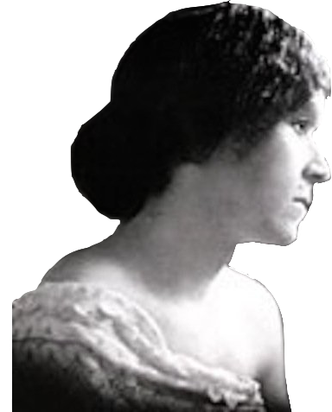
1880-1966
Georgia Douglas was born in Atlanta Georgia. Her mother was Native American and her father was African-American and English. She graduated from Atlanta University’s Normal School and taught school in
Marietta, Georgia. She left teaching to pursue her love of music in 1902 and attended Oberlin Conservatory of
Music in Ohio. Later she returned to Atlanta where she
became the assistant principal at a public school. She married Henry Lincoln Johnson in 1903. Her husband’s job moved their family to Washington D.C. where Georgia was a homemaker, raising their two sons. She spent her time writing poetry, plays songs, giving music lessons, and playing the organ for her church.
After her husband’s death, Georgia began contributing written works and hosting arts gatherings for members of the Harlem Renaissance- a group she was active in and supported until her death in 1966. She was inducted into the Georgia Writer’s Hall of Fame in 2009.

Slide 16
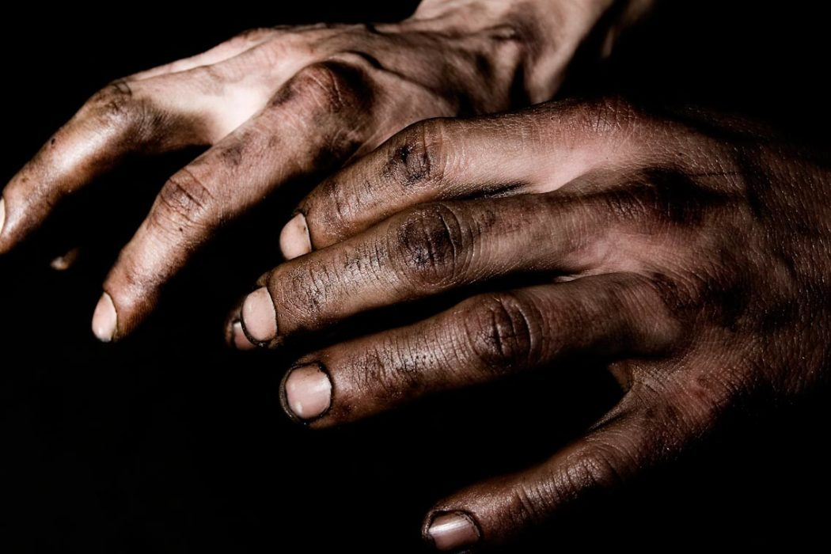
1.
Common Dust
And who shall separate the dust
What later we shall be:
Whose keen discerning eye will scan
And solve the mystery?
The high, the low, the rich, the poor,
The black, the white, the red,
And all the chromatique between,
Of whom shall it be said:
Here lies the dust of Africa;
Here are the sons of Rome;
Here lies the one unlabelled,
The world at large his home!
Can one then separate the dust?
Will mankind lie apart,
When life has settled back again
The same as from the start?

Slide 17

2.
Your World
Your world is as big as you make it.
I know, for I used to abide
In the narrowest nest in a corner,
My wings pressing close to my side.
But I sighted the distant horizon
Where the skyline encircled the sea
And I throbbed with a burning desire
To travel this immensity.
I battered the cordons around me
And cradled my wings on the breeze,
Then soared to the uttermost reaches
With rapture, with power, with ease!

Slide 18
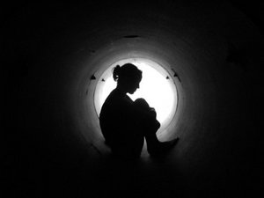
3.
My Little Dreams
I’m folding up my little dreams
Within my heart tonight,
And praying I may soon forget
The torture of their sight.
For time’s deft fingers scroll my brow
With fell relentless art-
I’m folding up my little dreams
Tonight, within my heart.

Slide 19

1905-1998
Lois Jones attended the School of Museum of Fine Art in Boston in the midst of strong discrimination against African Americans. Besides being a painter, Jones was also a textile designer and teacher. Her paintings incorporated African and, later in her life, Haitian sceneries. She had a passion for social justice, participated in the Harlem Renaissance, depicted images from Jim Crow and Civil Rights eras in the South, and documented scenes from travels around the world to places such as Haiti, Jamaica, Paris, and Cape Cod. In various stages of her life, her art was inspired by many styles. Her paintings range in styles and mediums from cubism, softer water colors, vibrant oil paintings, and even some impressionism. Jones taught at a prep school in North Carolina where she also coached the women’s basketball team. She then taught at Howard University for 47 years.

Slide 20
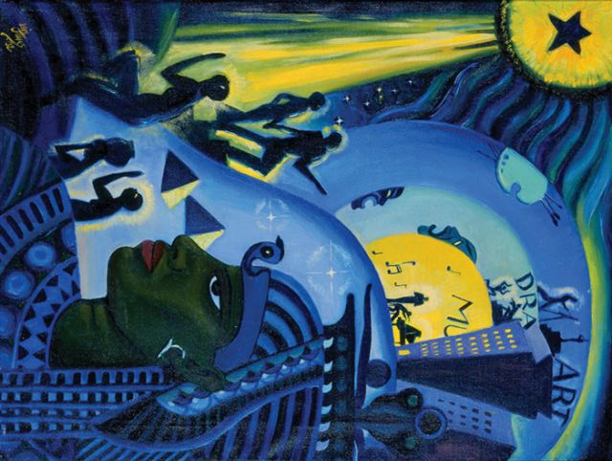
Lois Mailou Jones, “Ascent of Ethiopia”, 1932, Oil on Canvas

Slide 21
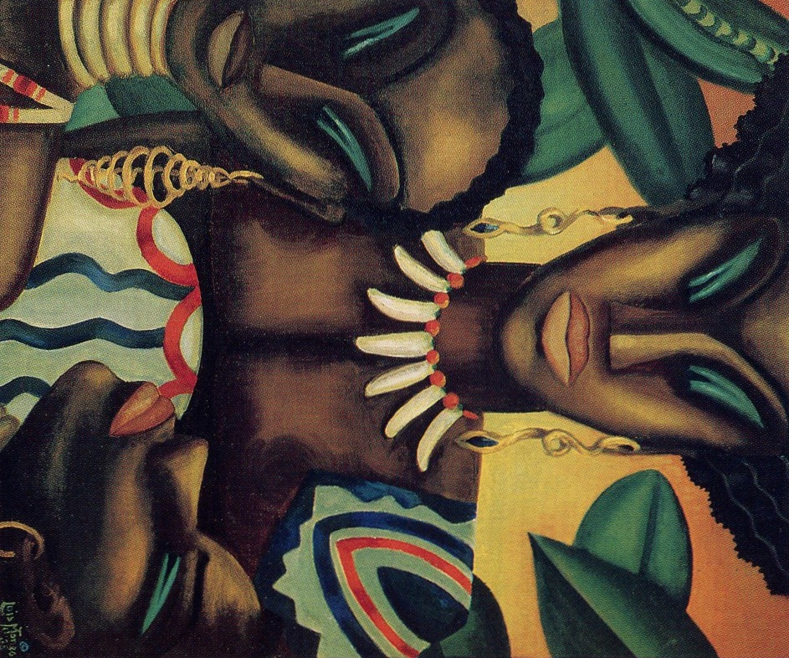
Lois Mailou Jones, “Africa”, 1935, Oil on Canvas

Slide 22
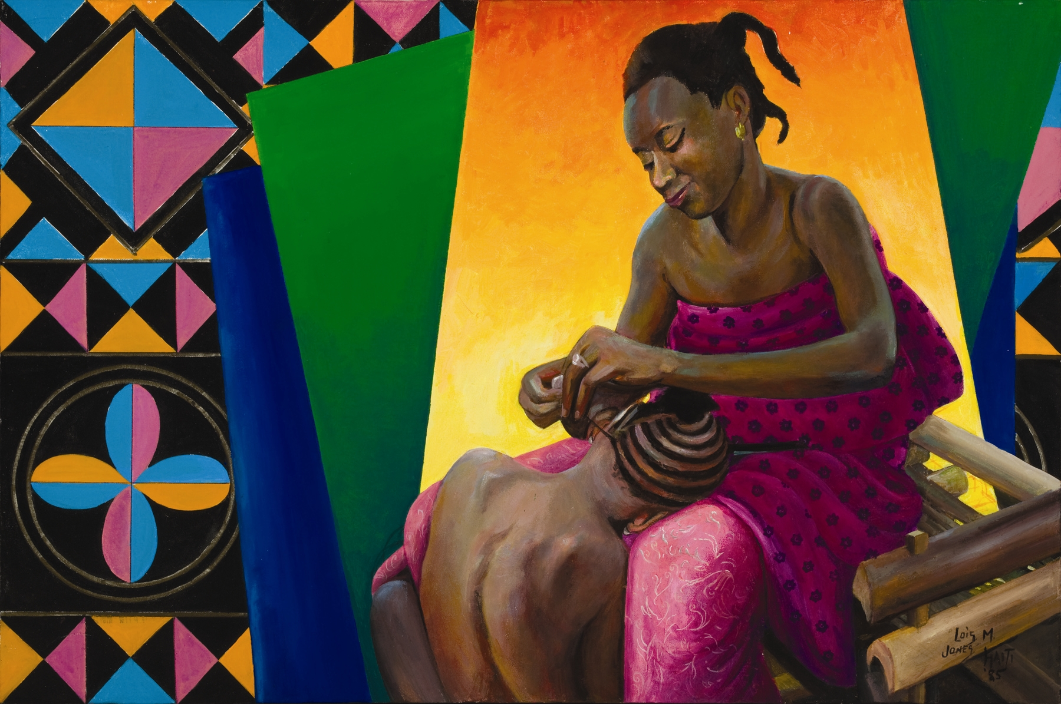
Lois Mailou Jones, “Mere du Senegal”, 1985, Acrylic on Canvas

Slide 23

Listen to the piece of music and answer the questions.
Describe the mood of this music.
What images do you think of when you hear this piece?
Listen to the piece of music and answer the questions.
Describe the mood of this music.
What is the message conveyed in this song?
Look at the three pieces of art and answer the questions.
Which collage do you like best?
Describe what you think is going on in that piece.
Look at the three pieces of art and answer the questions.
Which painting do you like best?
Describe what you think is going on in that piece.
Read the three poems and answer the questions.
Which poem was your favorite?
How does this poem identify with the experiences of African Americans?
Read the three poems and answer the questions.
Which poem was your favorite?
How does this poem identify with the experiences of African Americans?

