Slide 1
THE PROGRESSIVE PRESIDENTS
Between 1901 and 1919, three Presidents – Theodore Roosevelt, William Howard Taft, and Woodrow Wilson – launched a series of Progressive reforms from the White House that affected the entire nation.

Slide 2
THEODORE ROOSEVELT
Came from a wealthy NY family, was an avid hunter, was Police Commissioner of New York City, a rancher in Dakota, a cavalry commander, and governor of NY
Became President after William McKinley was assassinated in Buffalo, NY

Slide 3
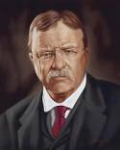
Theodore Roosevelt
In the late 19th century, the Presidency had been relatively weak. Roosevelt reversed this trend

Slide 4
HIS VIEWS ON THE PRESIDENCY
Believed President represented all Americans
Should lead in their interest
Was a man of action and was a “steward” of the people’s interests
Put to the test in the Coal Miners’ Strike of 1902
Miners went on strike
Roosevelt brought both sides together
When miners and owners refused to negotiate, he threatened the use of federal troops to run mines
Convinced the owners to compromise

Slide 5
AS A TRUST BUSTER
Was suspicious of big business
Big business consolidations were known as trusts (remember Rockefeller)
Tried to stop unfair, anti-competitive practices
He did not attack all trusts. Only those that acted against the public interest.

Slide 6
ROOSEVELT’S SQUARE DEAL
Launched new laws to protect consumer health and prevent false advertising
This limited the operation of the laissez-faire economy
He worked to preserve the nation’s natural resources
SEE YOUR HANDOUT OF SQUARE DEAL LEGISLATION. READ AND UNDERSTAND IT!

Slide 7
THE TAFT PRESIDENCY, 1909-1912
Roosevelt helped William Howard Taft win the Republican nomination for President in 1908
Taft was a conservative Progressive
Continued many of Roosevelt’s policies, such as trust-busting
Unable to lower tariffs as promised and returned some federal lands to public sale

Slide 8
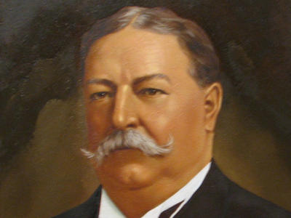
William Howard Taft
Was not a skilled politician and alienated many Progressives

Slide 9
WOODROW WILSON AND THE NEW FREEDOM 1913-1921
Roosevelt was angry with Taft’s failures
He decided to challenge Taft, but Taft won the Republican nomination
Roosevelt accepted the nomination of a third party, The Bull Moose Party
This split the Republican party vote and allowed the democratic nominee, Woodrow Wilson, to win

Slide 10
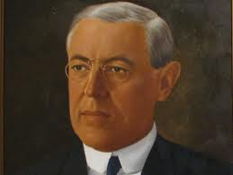
Woodrow Wilson
A professor of government, President of Princeton University, and Governor of New Jersey

Slide 11
New Freedom
Wilson was cool and logical
Like Roosevelt, he believed in a strong Presidency
Promised Americans a “New Freedom”
Taming big business
Encouraging greater competition
Eliminating special privileges
Focused his attention on attacking the tariff, banking system, and trusts
EXAMINE YOUR HANDOUT ON NEW FREEDOM LEGISLATION AND UNDERSTAND IT!

Slide 12
NATIONAL PARKS
Established in 1916
Brought 40 existing parks and monuments under federal protection
Purpose – to conserve the natural scenery, historic objects, and wildlife for the enjoyment of the American people

Slide 13
CHANGING ATTITUDES TOWARD UNIONS
The event that contributed the most was the fire at the Triangle Shirtwaist Factory in 1911
146 garment workers were killed
Factory doors had been bolted shut from the outside
Building lacked a sprinkler system
Only one inadequate fire escape

Slide 14
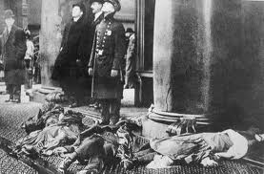
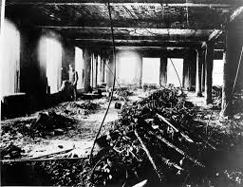
AFTERMATH OF THE TRIANGLE SHIRTWAIST FACTORY FIRE

Slide 15
CONGRESS PASSED LEGISLATION SYMPATHETIC TO UNIONS
Department of Labor (1913) – a separate cabinet post to study labor problems and enforce federal labor laws.
Clayton Anti-Trust Act (1914) – prevented courts from applying anti-trust laws to restrict unions. Also banned the use of federal injunctions to prohibit strikes in labor disputes.
Child Labor Act (1916) – Wilson passed a law prohibiting the sale of goods created by child labor in interstate commerce. It was overturned by the Supreme Court two years later.

Slide 16
Protecting the Public Health. Upton Sinclair’s account of the meat packing industry shocked the nation. Congress passed the Meat Inspection Act (1906), providing for government inspection of meat. The Pure Food and Drug Act (1906) regulated the preparation of foods and the sale of medicine.
SQUARE DEAL LEGISLATION
Regulating Transportation and Communication. Roosevelt increased the power of the Interstate Commerce Commission to regulate railroads, and gave it authority over the telegraph and telephone
Conserving the Nations Resources. Roosevelt drew attention to the need to conserve forests, wildlife, and natural resources. He stopped the practice of selling public lands for development and added millions of acres to the national forests and parks. He formed the National Conservation Commission to protect the nation’s natural resources.

Slide 17
Underwood Tariff (1913). Wilson believed that high tariffs benefited rich monopolists but hurt average Americans. He enacted a law lowering tariffs by 25%. To make up for the lost revenue, he introduced the nation’s first income tax
Graduated Income Tax (1913). In a graduated income tax, rich taxpayers are taxed at a higher rate than less well-off taxpayers. The original Constitution did not permit Congress to tax individuals on their income. The Sixteenth Amendment ratified in 1913, gave Congress the power to tax personal income.
WILSON’S LEGISLATIVE RECORD
The Federal Reserve Act (1913). The act reformed the banking industry for establishing 12 regional Federal Reserve Banks to serve as “bankers banks.” It further allowed the Federal Reserve to regulate the money in circulation by controlling the amount of money that banks could lend.
Antitrust Legislation. In 1914, Congress passed the Clayton Antitrust Act, increasing the federal government’s power to prevent unfair business practices. In addition, the Federal Trade Commission Act was created to further protect consumers against unfair business practices by corporations.

